Slide 1
Capabilities
August 2017

Slide 2
About Us

Slide 3
About Us
NSightsWorldwide, LLC. is a full-service Marketing Research firm offering traditional and digital research with a focus on cultural insights. This includes marketing consulting, quantitative and qualitative research.
What are we about
In 2005 NSightsWorldwide, LLC. was developed to be a resource for brands and companies with multicultural research needs.
The size of the multicultural universe is large and growing, predicted some day to be the majority of consumers in the United States. Immigration rates may digress under the current administration but, the birth rates remain strong.

Slide 4
Hence, in order to satisfy our objective(s) we must have a national, regional, and local scope for our research services.
Currently…

Slide 5
The U.S. Multicultural Universe is important.
 | Northeast Region | Midwest Region | South Region | West Region
Black/African American | 11.1% | 10.2% | 19% | 4.5%
AIAN | 0.2% | 0.5% | 0.5% | 1.3%
Asian | 6.4% | 3.0% | 3.2% | 9.9%
NHOPI | 0.0 | 0.0 | 0.1% | 0.5%
SOR | 0.4% | 0.1% | 0.2% | 0.2%
2 or more races | 1.9% | 2.1% | 2.0% | 3.3%
Hispanic | 14% | 7.6% | 17.2% | 29.7%
Total Minorities | 34% | 23.5% | 42.2% | 49.4%
NOTE:
AIAN – American Indian/Alaska Native
SOR – Some Other Race
2 or more races – Multiracial/biracial
Source: Census ACS data

Slide 6
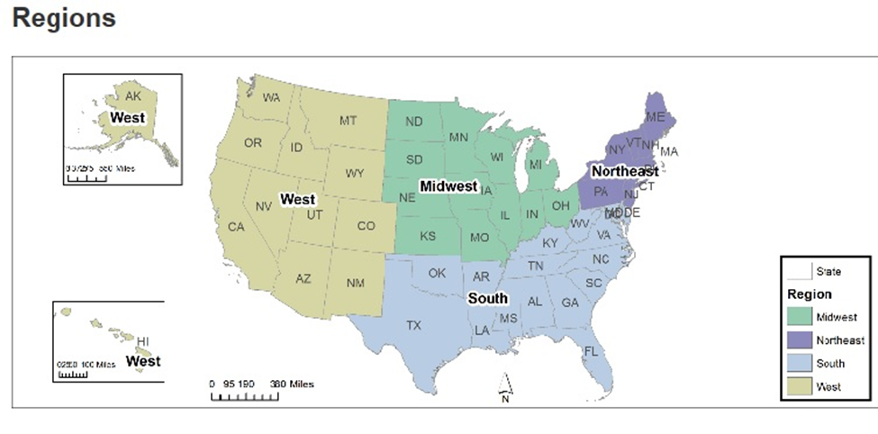
Two states are currently minority-majority states
and Florida and New York are close.

Slide 7
Additionally, we utilize the following methodologies to achieve the desired scope:
Mail
Online
Telephone
Landline
Mobil
Mall intercepts
Door-to-Door (personal interviews)
REPRESENTATIVENESS is critical to our marketing research. We have sample designs which deliver nationally representative and regionally representative samples for the total market as well as for any culture being targeted (i.e. African-American, Hispanic, Southeast Asian, and Asian Indian, mainly).

Slide 8
The goal of NSightsWorldwide (NSW) is to provide consumer insights that “jump-start” the market planning process.
To accomplish this goal we often employ qualitative research:
Group discussions (both traditional and virtually online)
“In-depth” interviews
‘Execute’ think tanks
Combination quantitative/qualitative efforts
NSW advocates the use of Emotional and Attitude Research to yield relevant cultural consumer insights.
Mini-groups

Slide 9
NSW’s Perspective on Strategy & Research for the Future

Slide 10
Trends affecting brand building
Brands are becoming less credible and losing relevancy.
As consumers have more choices, little or no differentiation is perceived between brands.
Consumers no longer think in terms of LOW prices but FAIR prices.
Consumers seek relevant and needed information in “their own terms.” Meaning, they no longer rely on media and advertising when seeking information.
Consumers learn about new brands, products and services through social media, user reviews, and recommendations from family & friends.
The growth in the U.S. Hispanic market has flattened.

Slide 11
New thinking behind brand building
Humanize brands to build meaningful relationships with consumers
01
Demonstrate the brand’s commitment and contributions to improving the wellbeing and lives of all
02
Leverage emotional brand attributes to differentiate from the competition
03
Emphasize end benefit to consumers over product features, innovations or price/promotions
04
Create and nurture real conversations between consumers and brands
05
Re-invent the media landscape; explore new communication channels as newer digital rends emerge and old ones evolve (i.e. Podcasts, silent videos, email)
06
The role of account planning is evolving a great deal to understand consumer behavior and attitudes online and offline, on-premise and off-premise
07

Slide 12
Account Planning has become the “guiding light” in the strategy and implementation process. Creative, Media, Digital, Direct Marketing, Events & Promotions, and PR departments demand more face time with Account Planning to help them do their work better.
A knowledgeable, talented and resourceful Account Planning & Research department is critical to succeed now and in the future.

Slide 13
ADVANTAGES OF NSW
Provides experts in cultural marketing and research
Vast experiences in conducting and integrating cultural research
Highly experienced in Automotive, Beverage (beer, liquor, soft drinks), Consumer Package Goods, Military Services and Financial categories
WHO ARE WE
NSW ‘gets the job done’ with experienced project directors, moderators and interviewers, analysts, statisticians, and strategists with skills that have been fine-tuned for over 100 years.

Slide 14
About the Founder and President

Slide 15
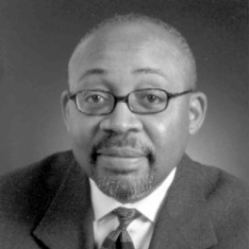
Ronald E. Franklin
President
Ronald E. Franklin is President and Executive Producer of NSightsWorldwide, LLC, a multicultural research and planning company. A graduate of the University of California at Los Angeles (UCLA) with a major in Mathematics and a minor in Economics, and of the UCLA Graduate School of Management where he received his M.S. in Management. Ronald has been a pioneer in multicultural marketing and research for the last 35 years, heading Research Services and Planning at Burrell Advertising and GlobalHue, two of the largest multicultural marketing and advertising agencies dedicated to strategically addressing the needs of African-American, Hispanic and Asian consumers. During this time, in 2005, NSightsWorldwide was conceived and it is now the focus of Ronald’s “global exploratory spirit”.
In 2006 Target Market News selected Ronald as the recipient of “Research Executive of the Year” marketing to African-Americans with Excellence (MAAX) Awards®. The MAAX Awards are presented annually to recognize the contributions, innovations and exceptional performance of African-American professionals in the fields of marketing, advertising, media and consumer research.
Ronald served on the Board of Directors of the Advertising Research Foundation (ARF; 2009-2013) and currently is a member of the Nielsen African-American Advisory Council, the UCLA Alumni Association, and the Minority Development Council (MMBDC).
For further information contact Ron at 248-302-5968

