Slide 1
Decoding Hidden Luxers

Slide 2
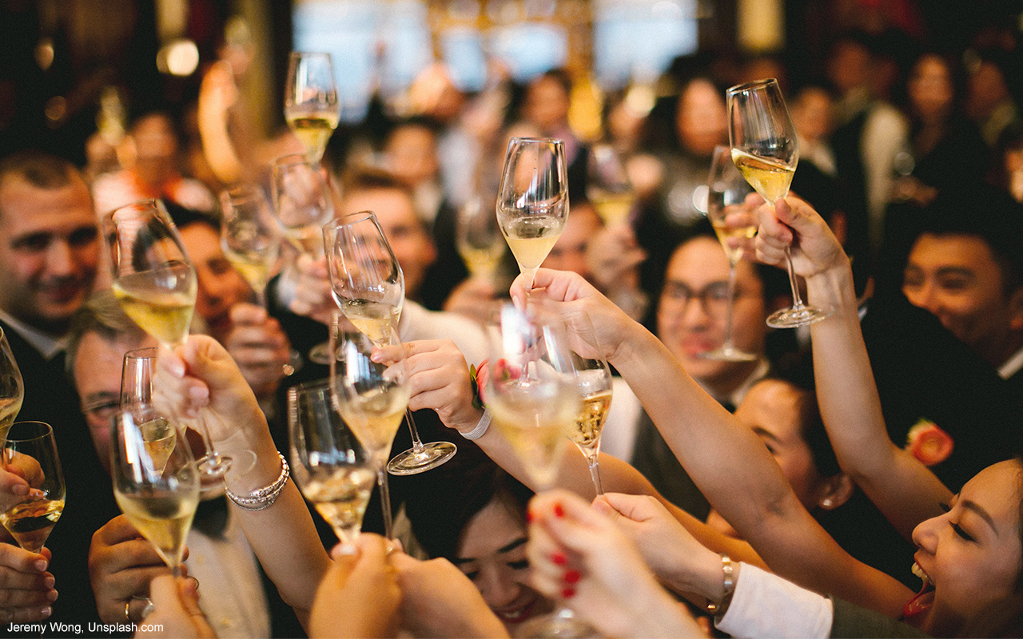
Decoding Hidden Luxers
Notes:
In our recent Hidden Figures work, we uncovered that the demographic makeup of the United States is becoming more culturally diverse, and the luxury market is no exception: Multicultural and LGBT consumers, thanks to their rising spending power and motivation to invest in higher quality products, are ready to jump into the luxury market. Decoding Hidden Luxers takes this work a click deeper, looking at each of the subgroups of Hidden Luxers — Asian American luxury consumers (Asian Luxers), US Latino luxury consumers (Latino Luxers), African American luxury consumers (Black Luxers) and LGBT luxury consumers (LGBT Luxers). These consumers will soon outnumber Visible Luxers, or white luxury consumers.
Each Hidden Luxer segment covets different facets of luxury: Some prioritize the social status that luxury provides, whereas others care more about the enhanced buying experience associated with luxury. Hidden Luxers also differ on luxury spend — both in how much they’ll spend on individual products and services and how much they’ll spend in total. This Quick Study provides a deeper dive into the nuances of how each Hidden Luxer segment perceives and spends on luxury products and services.

Slide 3
Decoding Hidden Luxers: Key Takeaways
Notes:
In this Quick Study, we explore the purchasing behaviors and the attitudes of Hidden Luxers:
Self-expression drives multicultural and LGBT consumers’ purchases, and they’ll pay a premium for luxury, thanks to their increased spending power and an optimistic outlook on finances.
Asian Luxers buy luxury products to improve social status, whereas Latino Luxers and LGBT Luxers look for products that match their identity. Black Luxers, on the other hand, prioritize the buying experience of luxury.
Black Luxers, more so than other segments, want affordable, entry-level luxury products. In contrast, LGBT Luxers are willing to pay top dollar for premium.

Slide 4
Multicultural and LGBT consumers look to spend on luxury
Notes:
Multicultural and LGBT consumers use luxury to express themselves and communicate their level of success to other people. At the same time, these consumers feel optimistic about their personal finances. As a result, they are highly interested in buying higher quality luxury products, and they have the necessary spending power to do so.

Slide 5
Multicultural and LGBT consumers want to showcase the self
Notes:
Social motivators like expressing one’s character encourage multicultural and LGBT consumers’ purchase of luxury products and services. Values like individuality and self-expression rank much higher for all multicultural and LGBT consumers compared to white consumers. At the same time, Hidden Luxers, especially Asian Luxers, use luxury to demonstrate a higher social status (CEB Iconoculture Luxury Survey, January 2017). Reflecting this trend, the value of ambition also resonates more with multicultural and LGBT consumers.

Slide 6
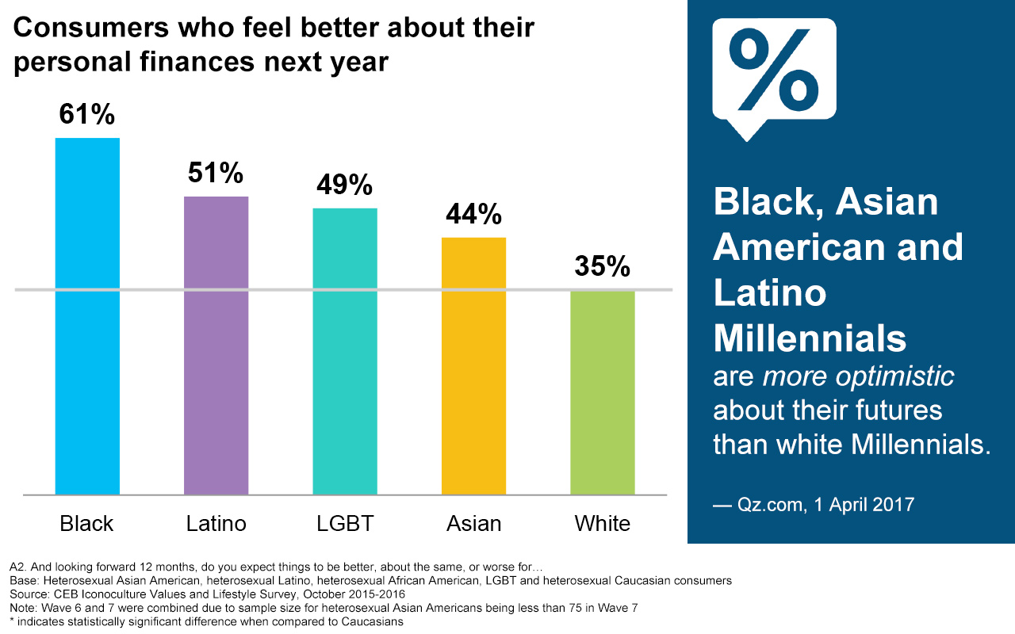
Multicultural and LGBT consumers expect a brighter future
Notes:
Despite dealing with the “worst year ever” and post-election tension, multicultural and LGBT consumers are holding on to their optimism. Compared with white consumers, significantly* more multicultural and LGBT consumers say they feel better about their personal finances in the next 12 months. In addition, multicultural Millennials have a more positive outlook on their future generally than white Millennials do.
*Statistically significant (mathematically meaningful) difference between multicultural and LGBT consumers vs. white consumers

Slide 7
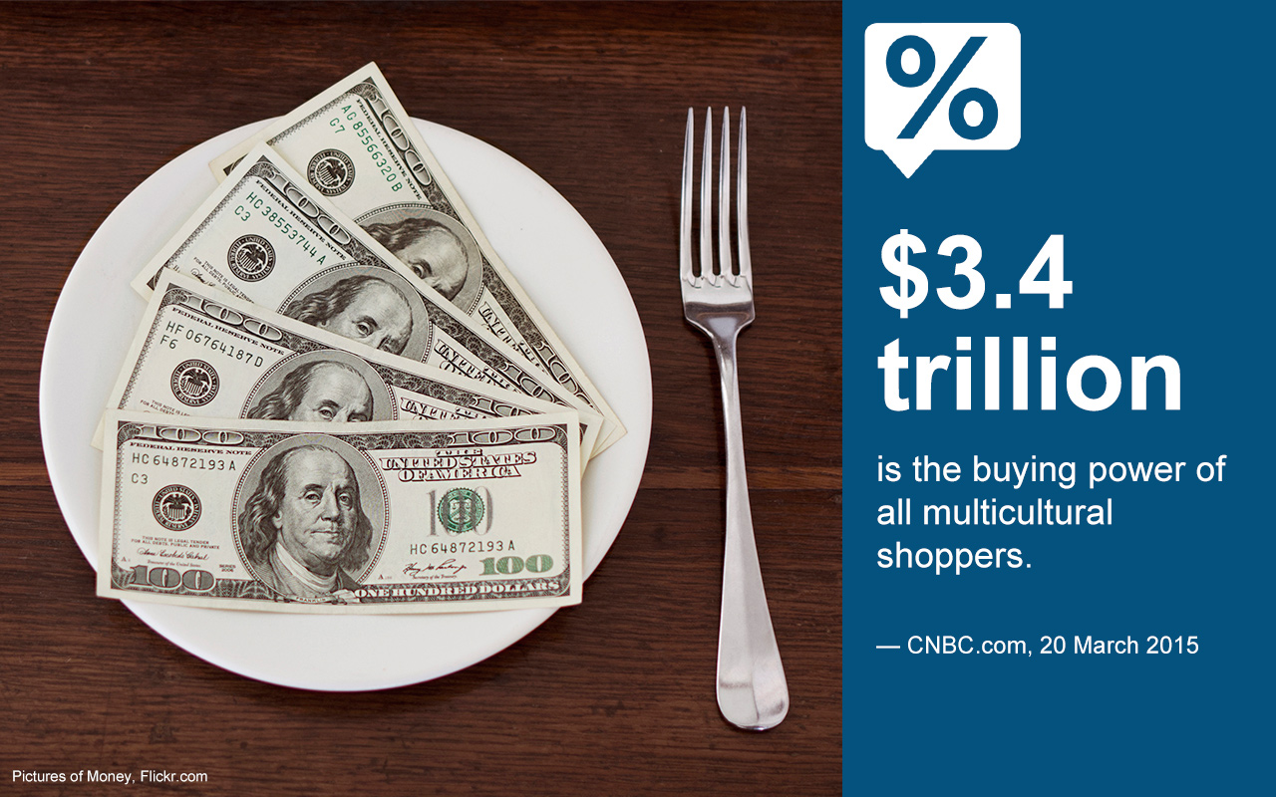
Multicultural and LGBT consumers can afford name brands
Notes:
Powered by their financial optimism and their desire to express themselves, multicultural and LGBT consumers are willing to open their wallets for luxury products and services. In fact, multicultural consumers prefer name brands over private labels, because private labels imply lower quality. They also have $3.4 trillion in collective buying power. LGBT consumers are equipped with $1 trillion, so they can afford to spend on luxury.

Slide 8
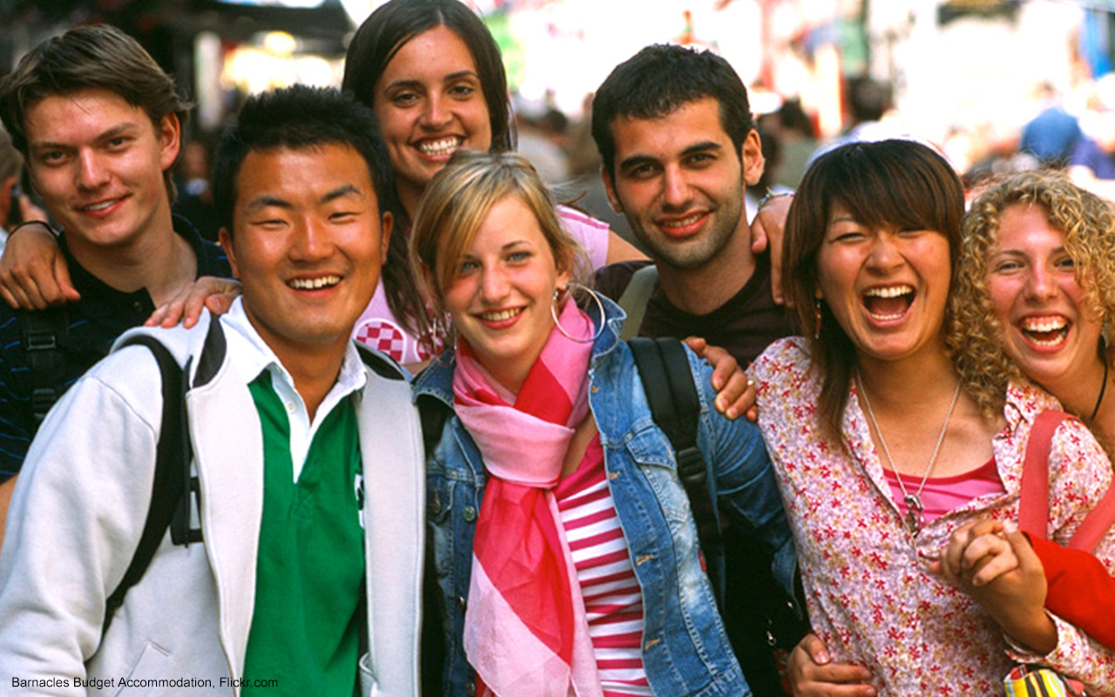
Different aspects of luxury appeal to different segments
Notes:
Multicultural and LGBT consumers may share the desire to express themselves through buying luxury, but when they do buy luxury, each Hidden Luxer segment — that is, each luxury-buying consumer group — looks for different things in luxury brands. Asian Luxers wish to impress people around them and achieve a sense of exclusivity through luxury, whereas Latino and LGBT Luxers seek luxury products that match their self-identity. Black Luxers, more than others, care about the overall buying experience of luxury products.

Slide 9
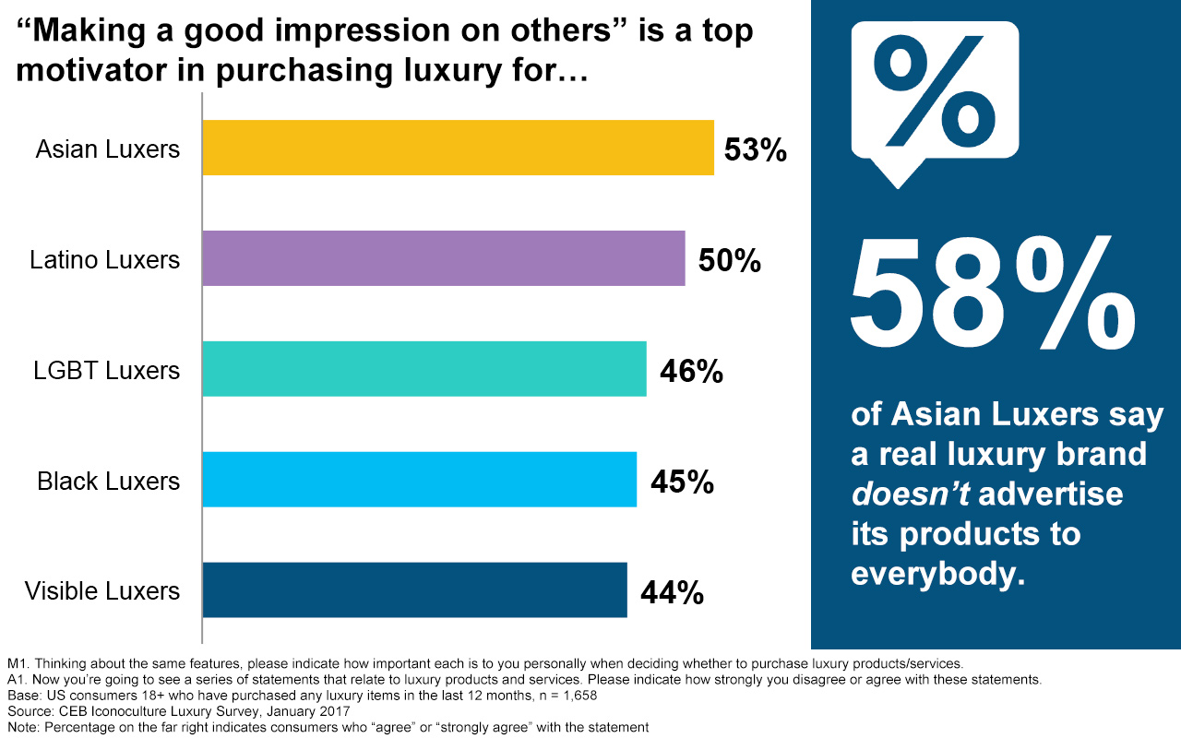
Asian Luxers want social status and exclusivity
Notes:
Hidden Luxers as a whole look to have higher social status and a sense of exclusivity by purchasing luxury, and this is especially true for Asian Luxers. Specifically, Asian Luxers wish to leave a good impression on others by showcasing luxury, and over half of them believe that real luxury brands do not target everyone. Bora, an Asian American Millennial living in urban New York, aptly summarizes this trend: “In fashion, there are lots of labels that appeal to individuals who would like alternatives to the traditional luxury brands. I think such low-profile but premium brands appeal to me more” (IconoCommunities, February 2017).

Slide 10
Latino and LGBT Luxers use luxury to communicate the self
Notes:
All Hidden Luxers expect to showcase their identity through purchases, but Latino and LGBT Luxers are especially likely to open their wallets for luxury products and services that match their identity. Case in point, 70% of Latino and LGBT consumers prioritize whether a luxury product matches their identity, a higher percentage than other Hidden Luxers.

Slide 11
Black Luxers want a luxurious buying experience
Notes:
Black Luxers are more likely than other Hidden Luxers to emphasize the buying experience — store environment, customer service, perks, etc. — of luxury products and services. Specifically, 62% of Black Luxers agree that luxury products or services are things that have a superior buying experience, with over a third agreeing that luxury isn’t luxury without it.

Slide 12
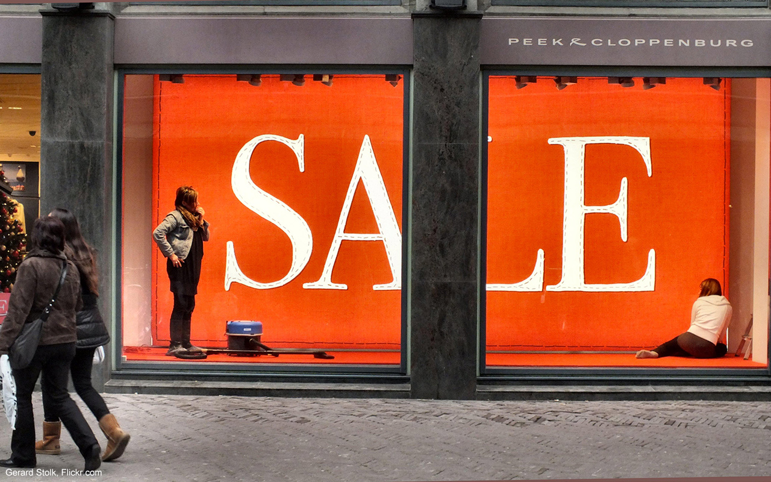
Affordability of luxury varies among Hidden Luxers
Notes:
While Hidden Luxers as a whole are willing to spend on luxury, the amount they spend differs for each segment. Black Luxers spend the least on luxury purchases. They want more accessible, entry-level options, but their expectations for quality of luxury products remain high. In contrast, LGBT Luxers spend the most money on luxury, and they think that the high price is justified.

Slide 13
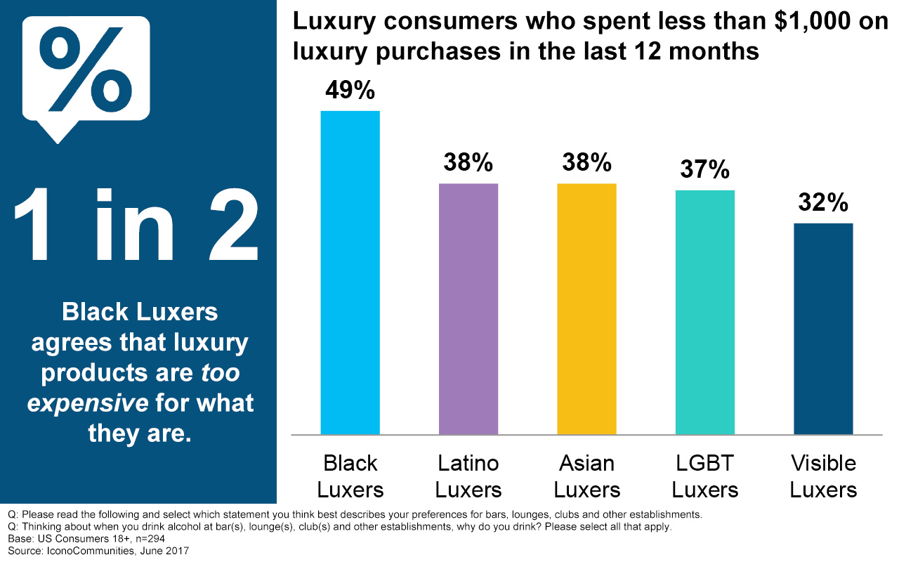
Black Luxers spend in the affordable luxury range
Notes:
Hidden Luxers may be ready to open their wallets, but not all spend top dollar for luxury. Many Black Luxers take issue with the price point of luxury brands — over half of them (53%) agree that luxury products and services are too expensive for what they are. So Black Luxers dedicate smaller chunks of money to buying luxury products and services, and growth in luxury purchases has been the slowest for Black Luxers. They were the least likely luxury consumer group to say that they have increased their spending on luxury in the last five years (CEB Iconoculture Luxury Survey, January 2017).

Slide 14
Black Luxers want accessible, quality luxury products
Notes:
Given their relatively lower luxury spend, it makes sense that Black Luxers want luxury products and services to be accessible. Specifically, over half of Black Luxers agree that everyone should have access to luxury products. However, that doesn’t mean quality should be compromised; just like all luxury consumers, Black Luxers say that quality is the most important element of luxury products.

Slide 15
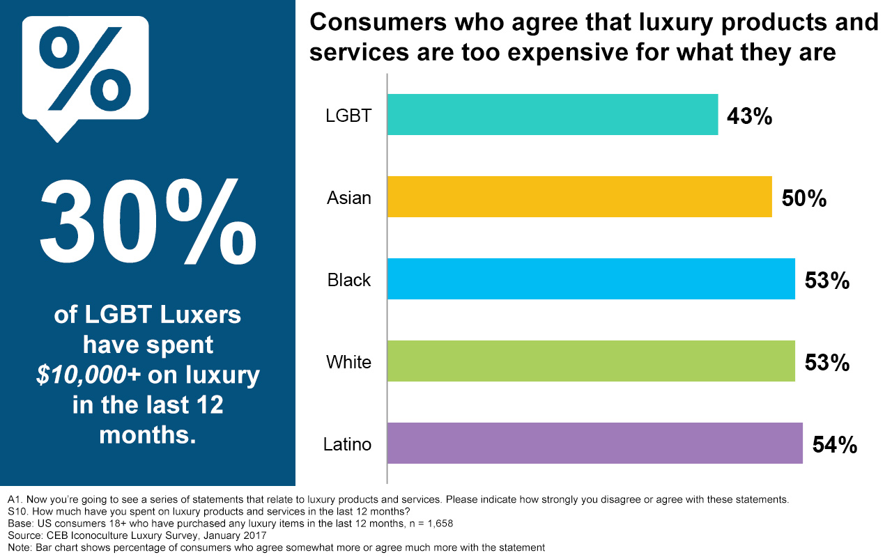
LGBT Luxers feel that the price of luxury is justified
Notes:
With high spending power, LGBT Luxers aren’t put off by the price of luxury. Specifically, compared to other segments, fewer LGBT Luxers feel that luxury products and services are too expensive. Reflecting this attitude toward luxury, LGBT Luxers are more likely to have spent over $10,000 on luxury in the past year. And as long as the quality of the luxury product matches the high price, LGBT Luxers are willing to pay: 1 in 4 gay men states that he will spend more money for “top quality brands” (Business Insider, June 2013).

Slide 16
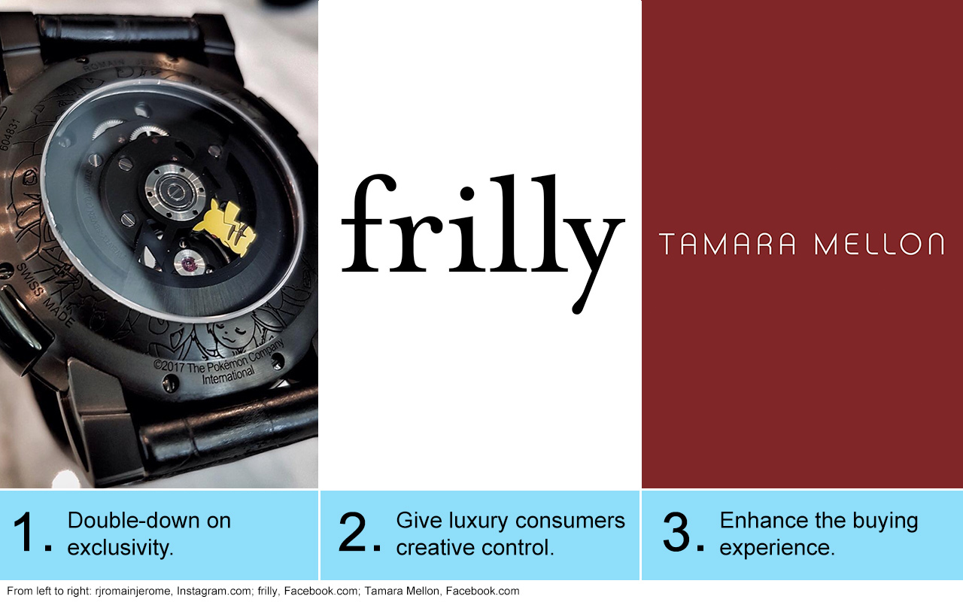
The Marketer’s Toolkit
Notes:
Multicultural and LGBT consumers have the necessary money for buying luxury products and services, and they are willing to spend it in order to better express their individual identity. At the same time, each Hidden Luxer segment differs in terms of which aspect of luxury appeals to them.
Luxury brands face the challenge of navigating through these different trends for each consumer group. Smart marketers appeal to the Hidden Luxers by 1) providing unique themes to their products and services to increase brand exclusivity, 2) allowing customers to freely express their identity through customization, or 3) creating a premium buying experience.

Slide 17
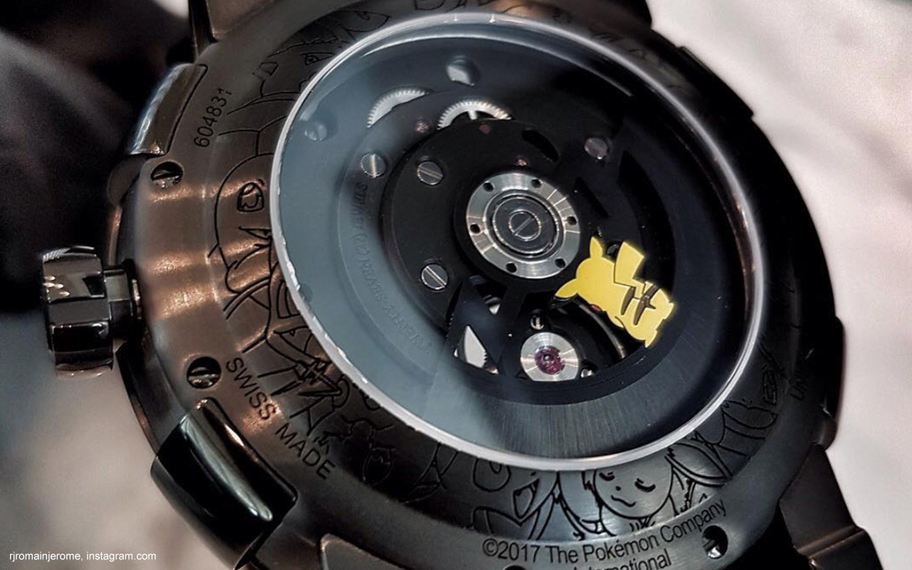
Tactical Tip #1: Double-down on exclusivity
Notes:
Close to half of all Hidden Luxers consider exclusivity a top motivator for buying luxury products and services, and the heightened social status that comes with it is especially attractive for Asian Luxers. Romain Jerome, a luxury watch maker, offers a chance for Luxers to stand out among the rest by offering unique themes like videogames. And in the name of attaining exclusivity, consumers have been willing to pay: The Pokémon 20-year anniversary watch, priced at $200,000 and limited to a stock of 20, sold out.

Slide 18
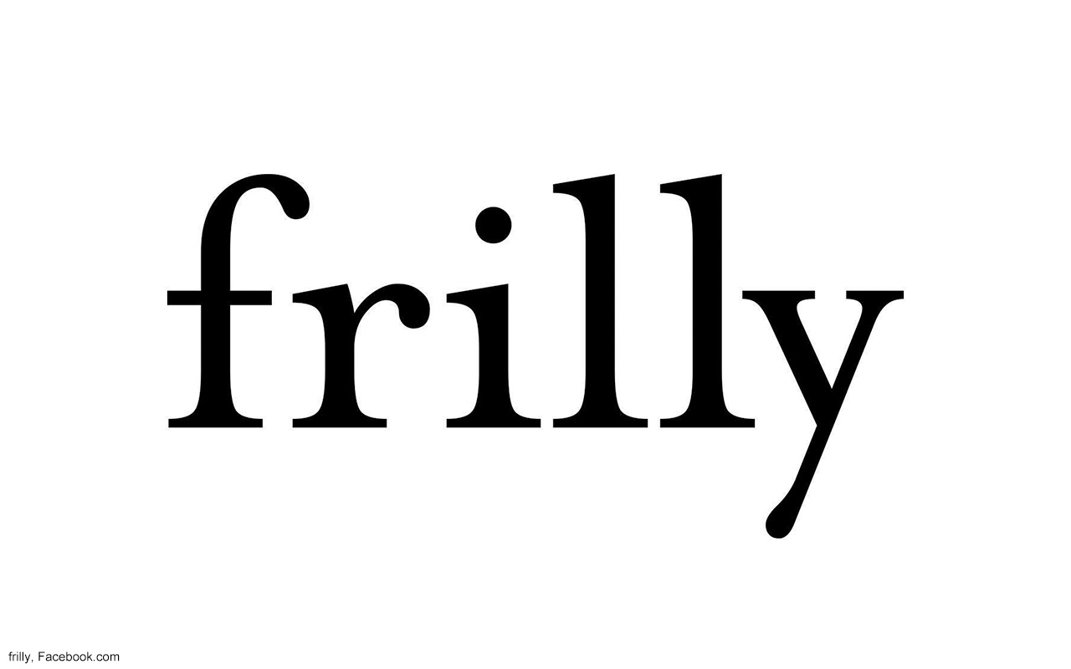
Tactical Tip #2: Give luxury consumers creative control
Notes:
With Hidden Luxers as a whole looking to express themselves through luxury, brands should facilitate consumer creativity, particularly that of Latino and LGBT Luxers. The fashion online platform Frilly succeeds by allowing consumers to choose a dress of their liking and fully customize it with their own colors, hem lengths, collar and sleeve designs, and so on. Consumers need not worry about over-editing their dress, as Frilly claims that “no matter who is on the site — even if they know nothing about fashion — can’t ever customize anything that won’t be flattering” (Forbes.com, 29 August 2017). Frilly also guarantees high-quality fabrics from Italy, Japan and France — an added bonus for luxury consumers.

Slide 19
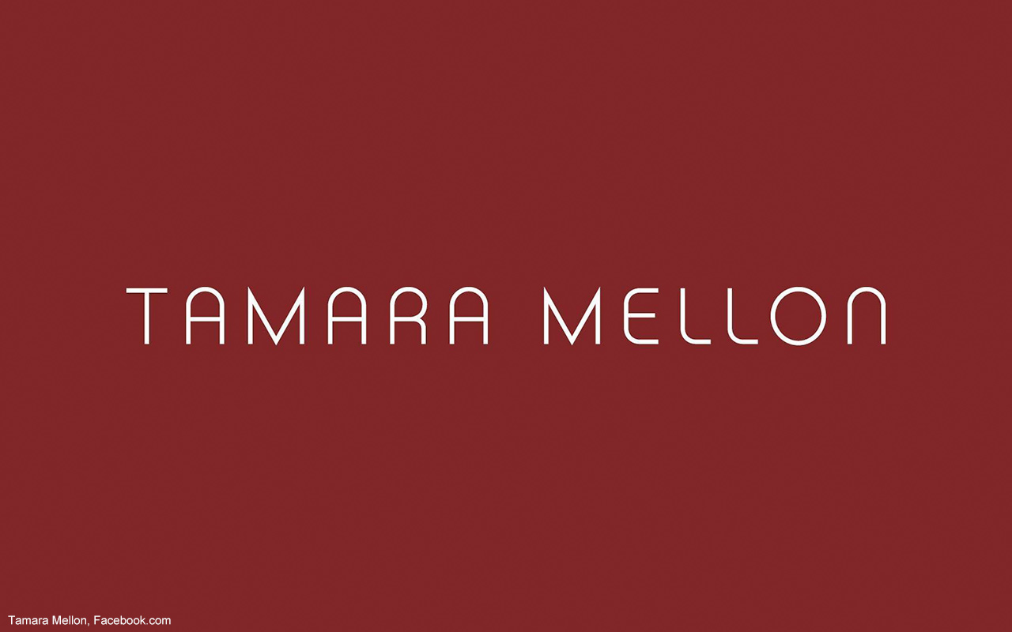
Tactical Tip #3: Enhance the buying experience
Notes:
For many consumers — notably, Black Luxers — luxury is all about the vibe, the customer service and the presentation of products at stores. Tamara Mellon found success by opening up a stilettos pop-up store that comes with a cozy space to try on shoes in private. For patrons of Tamara Mellon, the purchase itself becomes a form of luxury: They can “feel the product” while sipping a glass of champagne, and they also have the option of being personally styled by the store clerks.

Slide 20
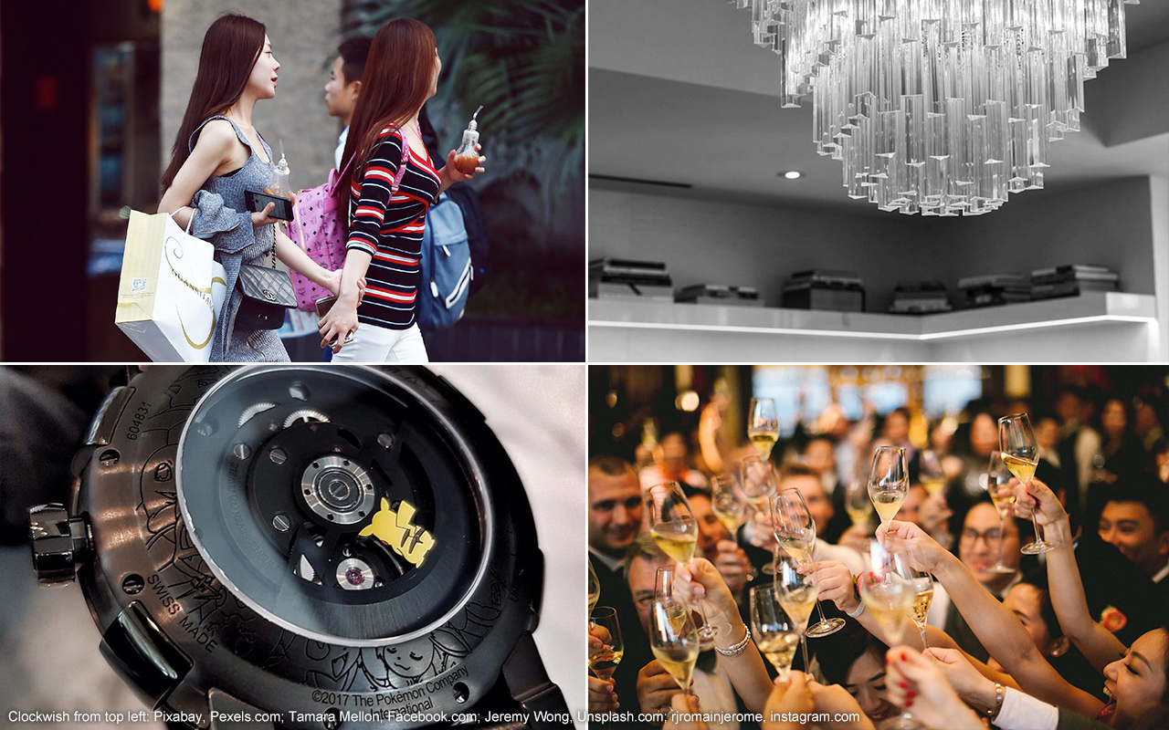
Rapid Recap
Notes:
1. With money to spend, multicultural and LGBT consumers are looking to purchase luxury goods and services in order to express themselves.
2. Different Hidden Luxer segments desire different things from luxury. Asian Luxers are attracted by exclusivity, whereas Latino and LGBT Luxers look for luxury products that match their identities. Black Luxers want the buying experience itself to be superior.
3. Luxury spend varies among Hidden Luxers. Black Luxers look for entry-level options, while LGBT Luxers are willing to pay a premium.
4. Brands can appeal to each Hidden Luxer segment by playing up the exclusivity of luxury, offering customized products or services, or augmenting the buying experience.

Slide 21
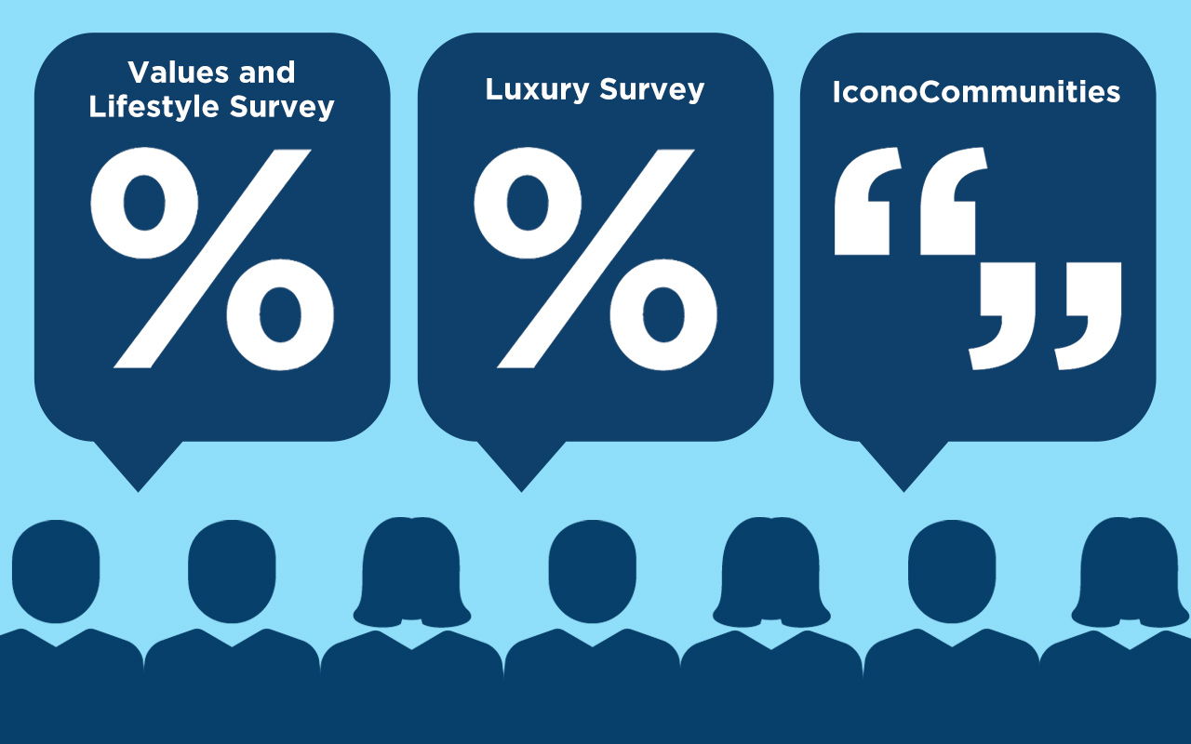
Our Methodology
Notes:
This Quick Study draws from CEB Iconoculture’s proprietary data assets:
• CEB Iconoculture Values and Lifestyle Survey, 2010-2016
• CEB Iconoculture Luxury Survey, January 2017
• IconoCommunities, February 2017
Secondary data sources are also used to complement proprietary data.

