Slide 1
Hidden Figures: Multicultural Consumers and Luxury

Slide 2
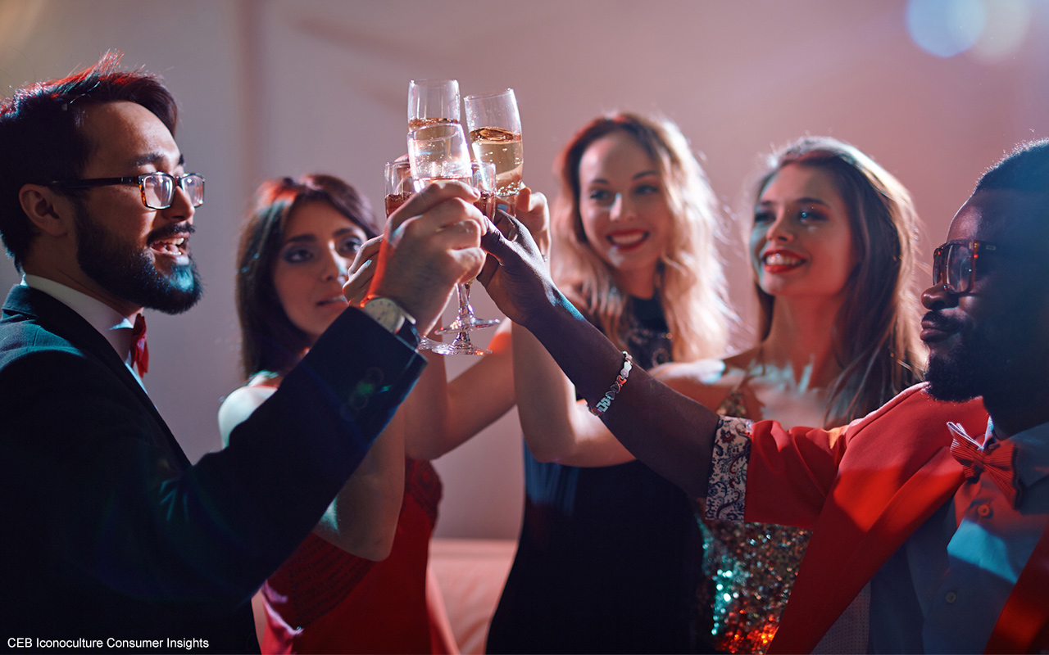
Hidden Figures: Multicultural Consumers and Luxury
Notes:
Luxury goods were once believed to be an old, rich, white man’s game. And while that assumption may still reign supreme in many brand strategy rooms, a growing — and soon to be majority — clientele of luxury goods has been quietly diversifying and defying old profiles. The good news is that traditional older and affluent luxury customers aren’t a flight risk, so the time is now for brands to shift strategy. By speaking to people of color, the LGBT community, Millennials and other modern luxury consumers, brands have an opportunity to preserve future profits while embracing the widening appeal of the luxury industry

Slide 3
Different values drive diverse consumers
Notes:
Today’s luxury good consumers have lower incomes, are more racially and economically diverse and are more likely to purchase luxury items because of social, intrinsic motivations (in keeping with multicultural consumers outsized thirst for self-expression – see Values Spotlight sidebar). Unfortunately, the growth of this emerging luxury buyer segment remains largely unnoticed by brands. While the reality of shifting American demographics is nothing new, luxury brands have been operating under the false assumption that they’re impervious to them. In reality, luxury goods buyers are changing in parallel with the US population, making it all the more important for luxury brands to increase their inclusiveness. Perhaps the biggest misconception about luxury good buyers is that they’re all wealthy, when in reality, 28% of Hidden Luxers fall in a lower middle income bracket (CEB Iconoculture Luxury Consumer Study, January 2017).

Slide 4
Hidden Luxers are ignored despite growing clout
Notes:
Unfortunately, the growth of this emerging Hidden Luxer segment remains largely unnoticed by brands. While the reality of shifting American demographics is nothing new, luxury brands have been operating under the false assumption that they’re impervious to them. In reality, luxury goods buyers are changing in parallel with the US population, making it all the more important for luxury brands to increase their inclusiveness. Perhaps the biggest misconception about luxury good buyers is that they’re all wealthy, when in reality, 28% of Hidden Luxers fall in a lower middle income bracket (CEB Iconoculture Luxury Consumer Study, January 2017).

Slide 5
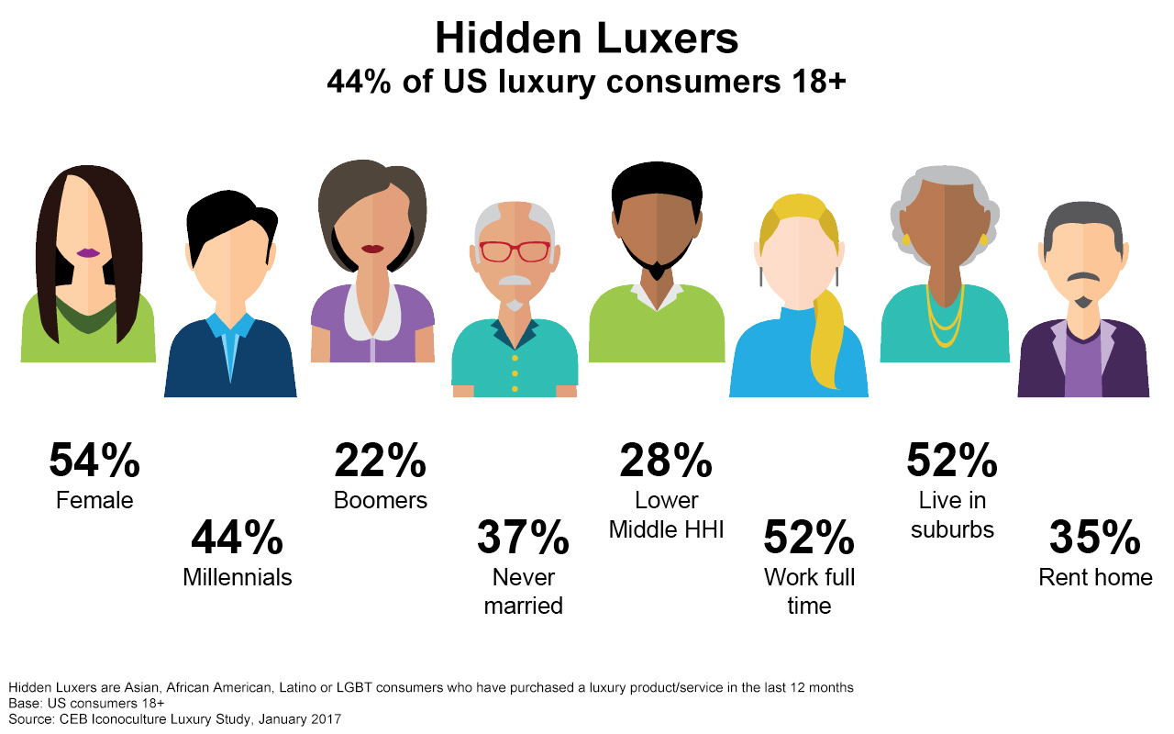
Hidden Luxers Spotlight
Notes:
When consumers who have purchased a luxury good within the past 12 months are divided by race, ethnicity and/or sexual orientation, a diverse profile emerges. Visible and Hidden Luxers differ in terms of gender, age, marital status, income level and where they live. Hidden Luxers tend to be female, younger, more suburban and lower earners.

Slide 6
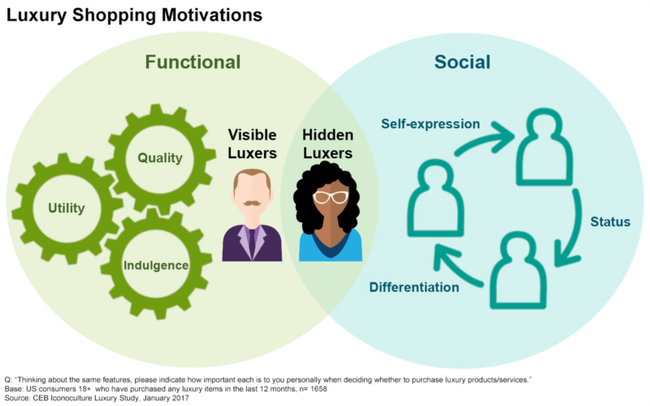
Social benefits motivate Hidden Luxers to buy
Notes:
While Hidden and Visible Luxers share several important motivators when it comes to buying luxury, only Hidden Luxers also consider social benefits — status, differentiation, self-expression — as motivation. The belief that you should get more if you pay more still holds true in the minds of all luxe buyers, and both groups look to luxury brands as a means of indulgence, but only Hidden Luxers show a desire to demonstrate social mobility through the purchase of luxury goods, and see luxury purchases as a way to signal their success to others (CEB Iconoculture Luxury Consumer Study, January 2017). For Hidden Luxers, high-cost purchases are a demonstration of social cachet, letting peers know that their status is rising, along with their level of sophistication.

Slide 7
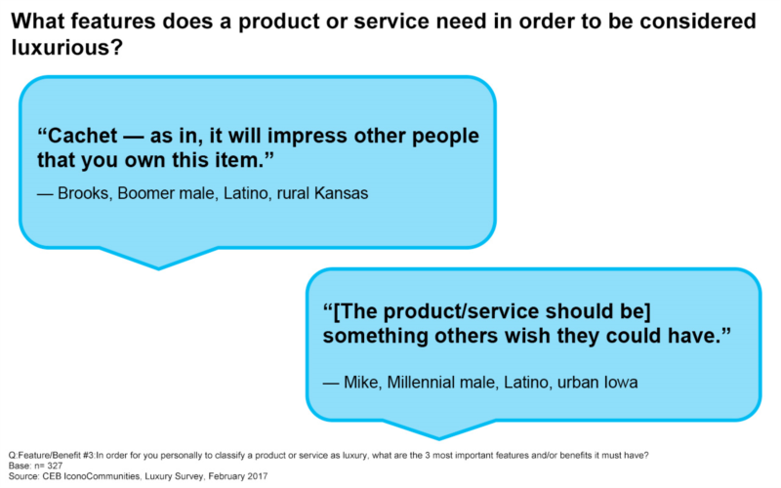
Hidden Luxers speak out on the social side of luxury
Notes:
For a product to be considered luxury by Hidden Luxers, social benefits are part of the equation.

Slide 8
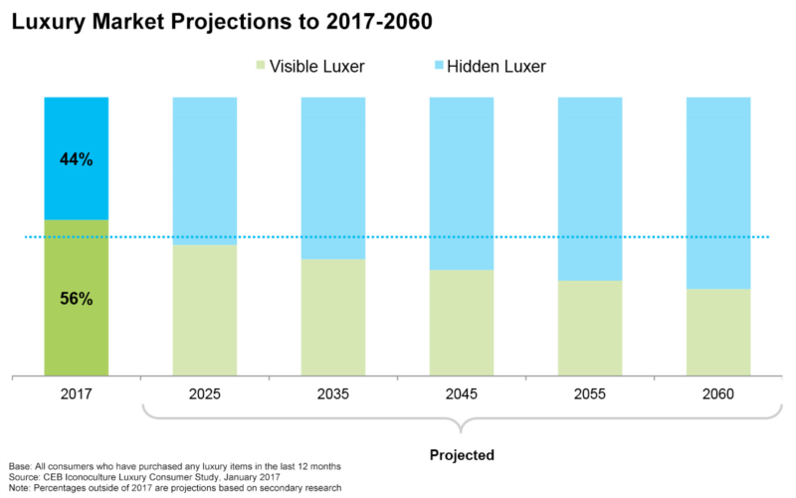
Hidden Luxers are the future of the luxury market
Notes:
Between 1990 and 2015, purchasing power of multicultural consumers saw an increase of 409% — more than double the growth of total US purchasing power (Selig Center for Economic Growth, 2015). Because Hidden Luxers are younger and make up the majority of younger people, their window for spending is longer than that of Visible Luxers (Nielsen, 18 March 2015). Additionally, they’re more loyal to their brands of choice (Buzz Marketing Group, 7 November 2016). Today, the numbers of Visible and Hidden Luxers are roughly split 50/50 (CEB Iconoculture Luxury Consumer Study, January 2017). However, given the current rate of change in the overall US population from a majority white to a minority-majority society, Hidden Luxers are poised to become the majority of all luxury consumers within the next five years.

Slide 9
The Marketer’s Toolkit
Notes:
With only a few years to go before Hidden Luxers become the majority of all luxury good consumers, luxury brands need to not only recognize this coming shift, but act quickly to address the unique purchasing motivations of Hidden Luxers. Sustainable brand growth depends on it. And it should be said that while the addition of a new type of motivation might appear to complicate luxury brands’ marketing strategies, all Luxers make it quite clear that they’re ok with brands branching out to new customers. A majority of Visible and Hidden Luxers say that they don’t have an issue with brands broadening their target (CEB Iconoculture Luxury Consumer Study, January 2017).

Slide 10
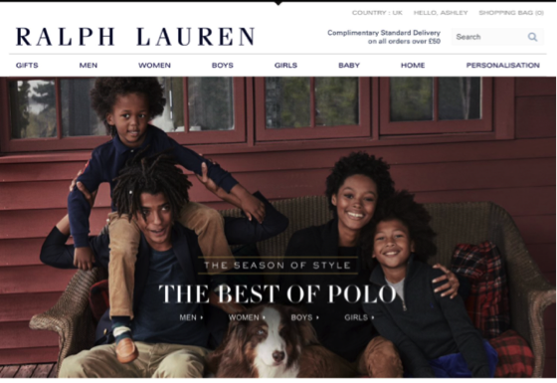
Tactical Tip #1: Adjust advertising in recognition of market diversity
Notes:
Ralph Lauren’s reflection of luxury through a young African American family with natural hairstyles highlights ethnic and age diversity. Ralph Lauren has also garnered strong praise from the African American community as a brand that has historically reached out to them.

Slide 11
Tactical Tip # 2: Reach Hidden Luxers by cueing up their social motivations
Notes:
Classic luxury brand Tiffany & Co. places Lupita Nyong’o near a New York City window to wax poetically about the grand view she now enjoys. The scene reveals only glimpses of jewelry and instead focuses on instilling the belief that this regal view (and the pricey apartment from which it’s viewed) might be available to all consumers. The company was also one of the first luxury jewelers to reach out to the LGBT community.

Slide 12
Tactical Tip #3: Reshape organizational priorities toward growth
Notes:
Cadillac was the car of choice for African American consumers in the early 2000’s. However, the brand unwisely changed strategies and stopped investing in black consumers, losing its market share to Lexus as that brand took the opposite tact throughout the 2010’s — partnering with Essence magazine, building interactive social media games in Web posts popular with African Americans, and creating high-profile Super Bowl spots featuring black celebrities. No wonder Lexus now consistently finds itself atop luxury vehicle rankings for black consumers.

Slide 13
Rapid Recap
Notes:
Today’s new luxury buyers — “Hidden Luxers” — are more diverse, in a range of ways
Social benefits motivate Hidden Luxers to buy
Hidden Luxers are a new, long-term engine of growth

